Slide 1
ASIA’S WHOLESALE
MIDSHORE INTERMEDIATION
CENTRE

Slide 2
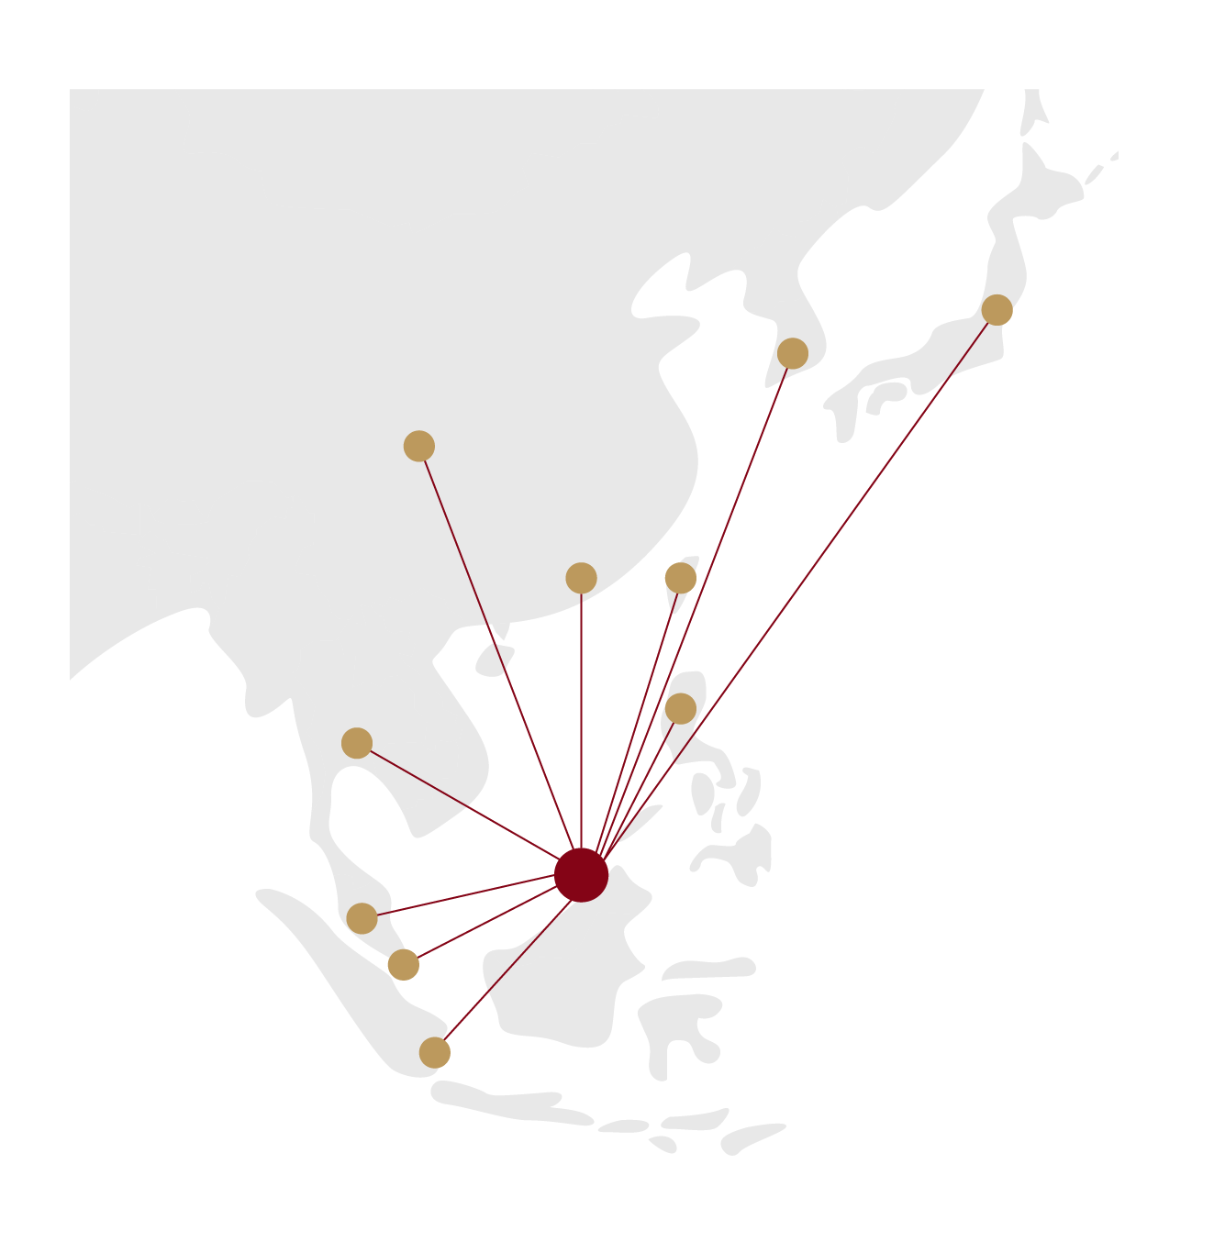
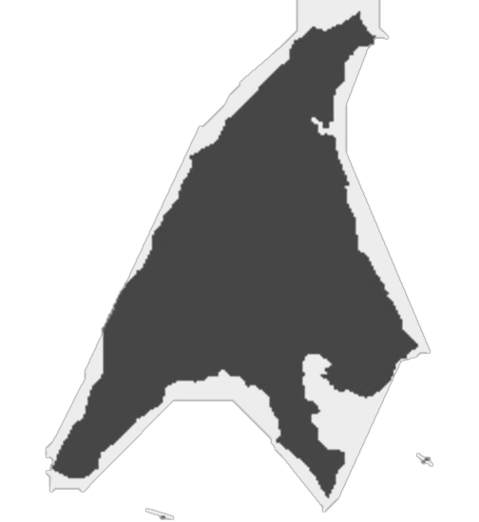

Where is Labuan?
Part of Malaysia, a Federal Territory under the Federal Government
Off the coast of Sabah, East Malaysia, in the center of Asia
Labuan derived its name from the word “labuhan” or a port - has naturally deep, well-sheltered harbour
Easy access from Kuala Lumpur and Kota Kinabalu
About 100,000 population
Japan
International Business & Financial Centre
Logistics
South Korea
China
Hong Kong
OUR
ECONOMIC DRIVERS
Taiwan
Tourism
Thailand
Manila
Kuala Lumpur
Singapore
LABUAN
Oil & Gas
Retail Trading
Strategically Located
Jakarta

Slide 3
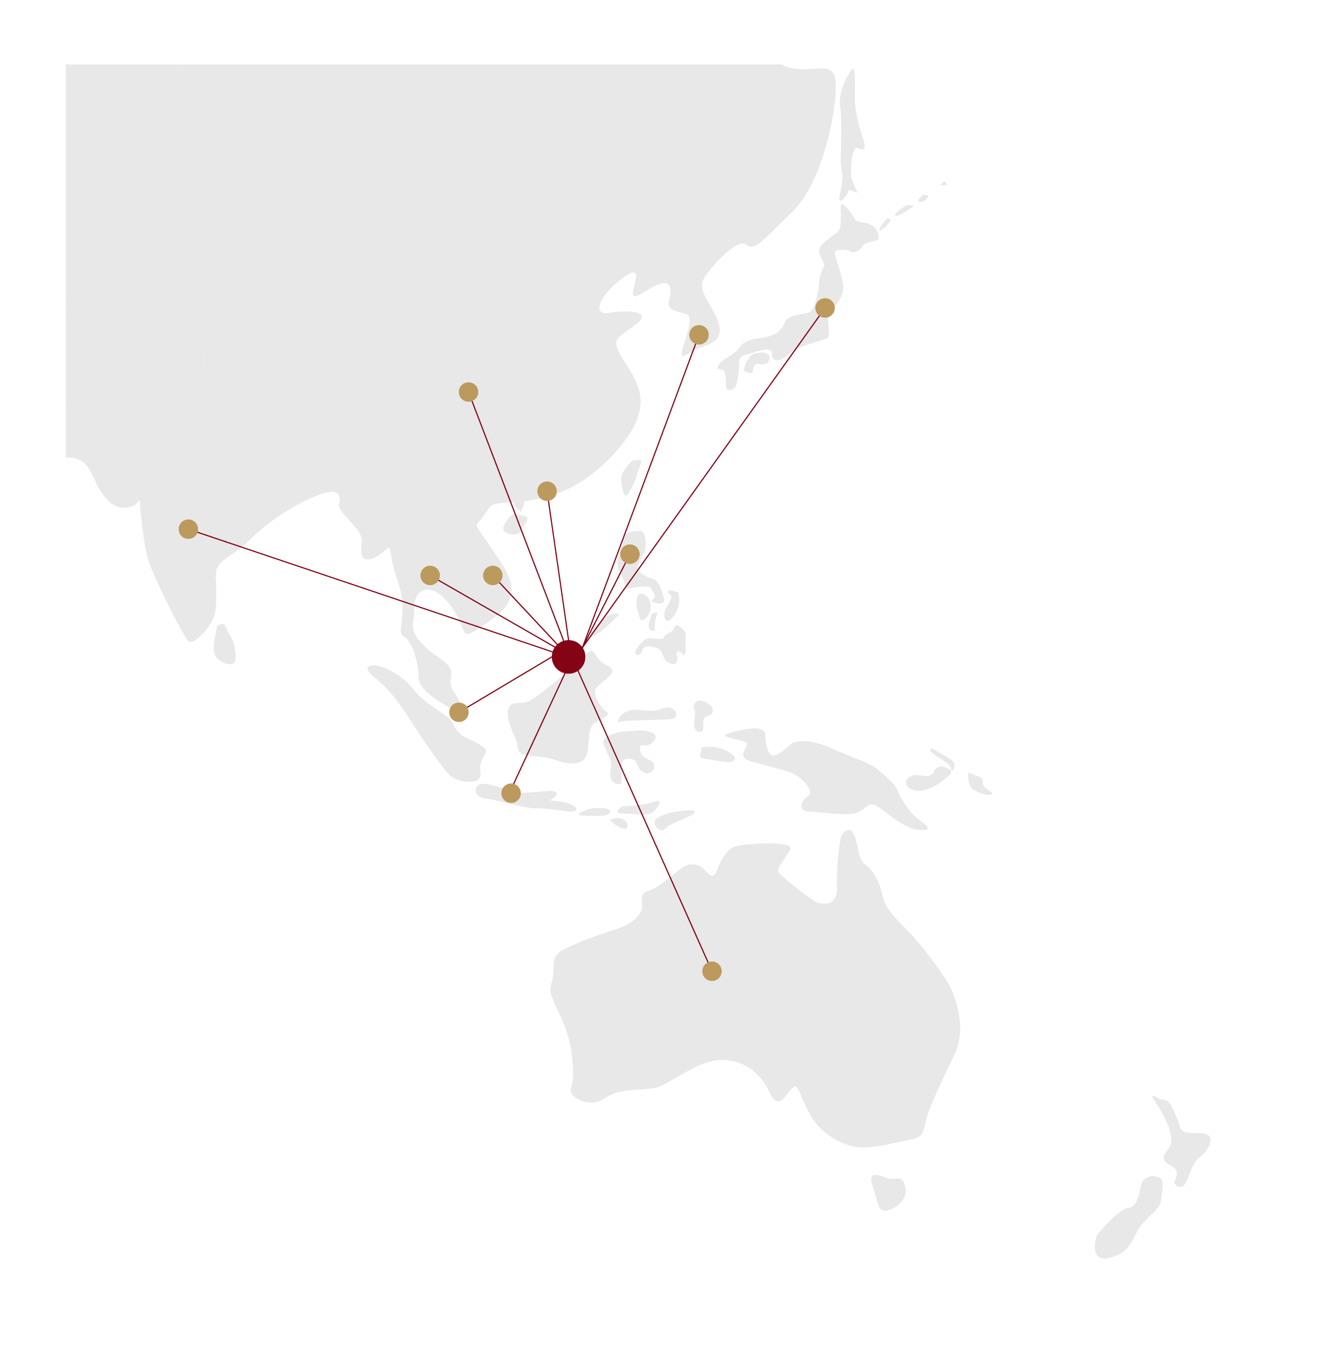
Labuan IBFC – Gateway to Asia Pacific
More than 30 Years of Intermediating Asia
An international business and financial centre set up by Malaysia in 1990 to intermediate trade, finance, risk and wealth.
A tax-efficient substance enabling MIDSHORE jurisdiction to facilitate businesses, trading, investments through financial services and a wide array of legal structures.
Well-balanced legal and regulatory framework, proportionality in regulatory stance.
Robust governing legislations passed by the Malaysian Parliament, administered by Labuan Financial Services Authority, a statutory body under the Ministry of Finance, Malaysia.
Adheres to Malaysia’s AMLCFT requirements and international standards and best practices set by multilateral global institutions.
South Korea
Japan
China
India
Hong Kong
Vietnam
Thailand
Philippines
Singapore
Indonesia
Australia

Slide 4
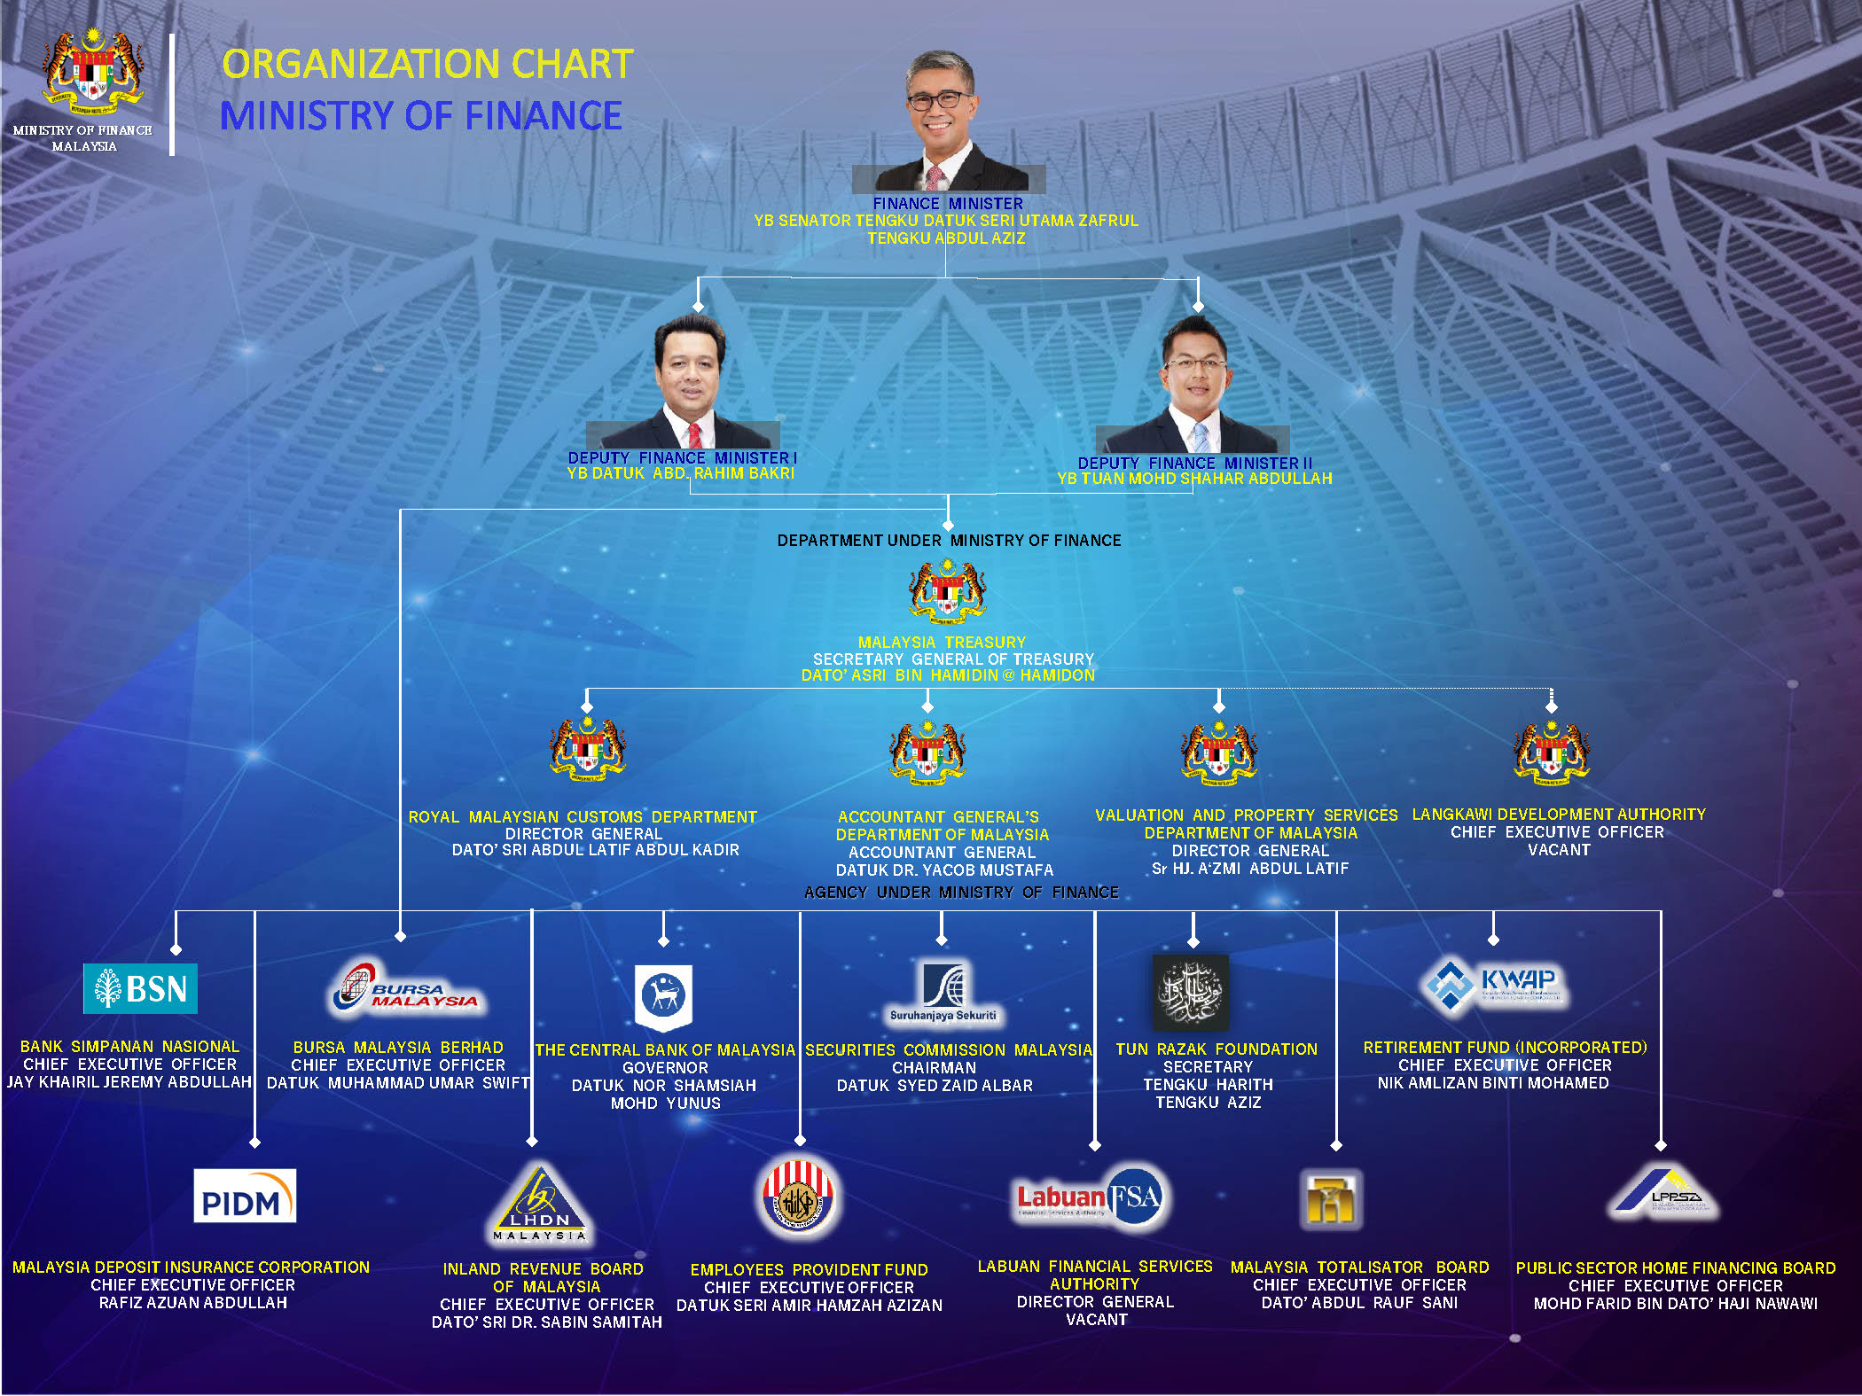
THE REGULATOR
Labuan Financial Services Authority
Labuan Financial Services Authority a statutory body under Ministry of Finance, Malaysia
NIK MOHAMED DIN NIK MUSA

Slide 5
Why the Mid-shore Balance?
Labuan is part of Malaysia, one of Asia’s fastest growing nations. Labuan IBFC is thus part of all the protocols the country adheres to, such as anti-money laundering and anti-terrorism financing regulatory requirements.
Conformity to international standards and regulatory requirements by international standards setting bodies such as OECD, APG, FATF, have always been key to Labuan IBFC.
Labuan IBFC has put in place relevant legislation to allow the exchange of information with the tax authorities of Malaysia’s double tax treaty partners as well as the tax information exchange agreements signed by Malaysia.
The range of unique and bespoke structures are cost-efficient, tax and currency neutral.

Slide 6

A Comprehensive Suite of Legislation
Adherence to International Standards and Best Practices
1. Labuan FSA
3. Acts of General
Applications include
Labuan Financial Services
Authority Act 1996
Labuan Companies Act 1990
Labuan Financial Services and Securities Act 2010
Labuan Islamic Financial Services and Securities Act 2010
Labuan Trusts Act 1996
Labuan Limited Partnerships & Limited Liability Partnership Act 2010
Labuan Foundations Act 2010
Anti-Money Laundering and Anti Terrorism Financing and Proceeds of Unlawful Activities Act 2001
Mutual Assistance in Criminal Matters Act 2002
Malaysia Anti – Corruption Commission Act 2009
National Anti- Financial Crime Centre Act 2019
BNM’s Foreign Exchange Notices
2. Inland Revenue Board
Labuan Business Activity Tax Act 1990 (LBATA)
Income Tax Act 1967 – including relevant gazette orders
Stamp Act 1949

Slide 7
Creating A Complete Ecosystem of Solutions
COMPANIES
BANKING
INSURANCE
Trading
Investment holding
Commercial banking
Investment banking
Direct Insurance
Reinsurance
Insurance broking
Captive Insurance
Underwriting and insurance manager
LEASING
TRUST COMPANIES
WEALTH MANAGEMENT
Big – ticket items including aircrafts, ships and
support-vessels
Specialized plants, machineries and equipment
Corporate secretarial services
Company administration
Trustee services
Accounting, tax and advisory services
Trust
Foundation
Family Office
CAPITAL MARKET
DIGITAL MARKET
COMMODITY TRADING
Private and public funds
Fund management
Securities licensee business
Fund administration
Exchange
Money broking
Credit token
Payment system
Petroleum and petroleum relates products and LNG
Agriculture
Base minerals
Chemicals
Refined raw materials

Slide 8
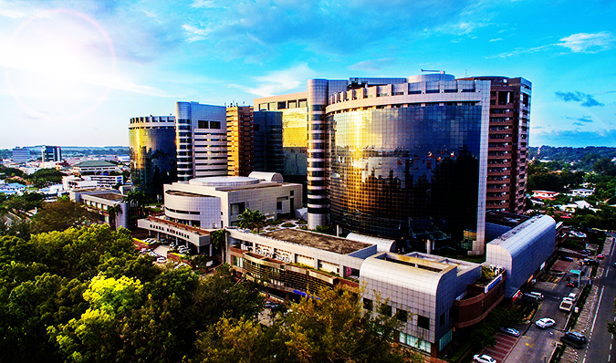
Fiscal Structure and Corporate Entity Benefits
Tax Structure
  Income from Labuan trading activities (as defined) taxed at 3% of net audited profits
  Non-trading income (e.g., from investment holding activities) attracts no tax
  Clear and prescribed Substance Requirements based on business activities via a Gazette issued by Parliament of Malaysia
  Fiscal Regime is perpetual not time bound
Business and Investment Activities
Other Benefits
Other Benefits
  Exemption from withholding tax on dividends, interest, royalties, service fees and lease payments to non-residents
  Exemption from stamp duty
  Access to most of Malaysia’s 70+ double taxation agreements*
  100% foreign ownership
  Access to live in Malaysia
  * Labuan entities enjoy the benefits of most of Malaysia’s tax treaties, but certain treaties have specifically excluded Labuan entities from treaty benefits

Slide 9































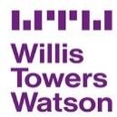








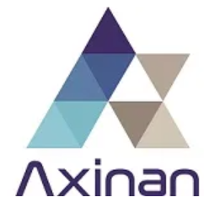












Home to International Brands
Banks
Insurance & Captives
Trust Companies
Leasing
Labuan International
Trading Companies
(LITCs)
Digital Financial
Services

Slide 10
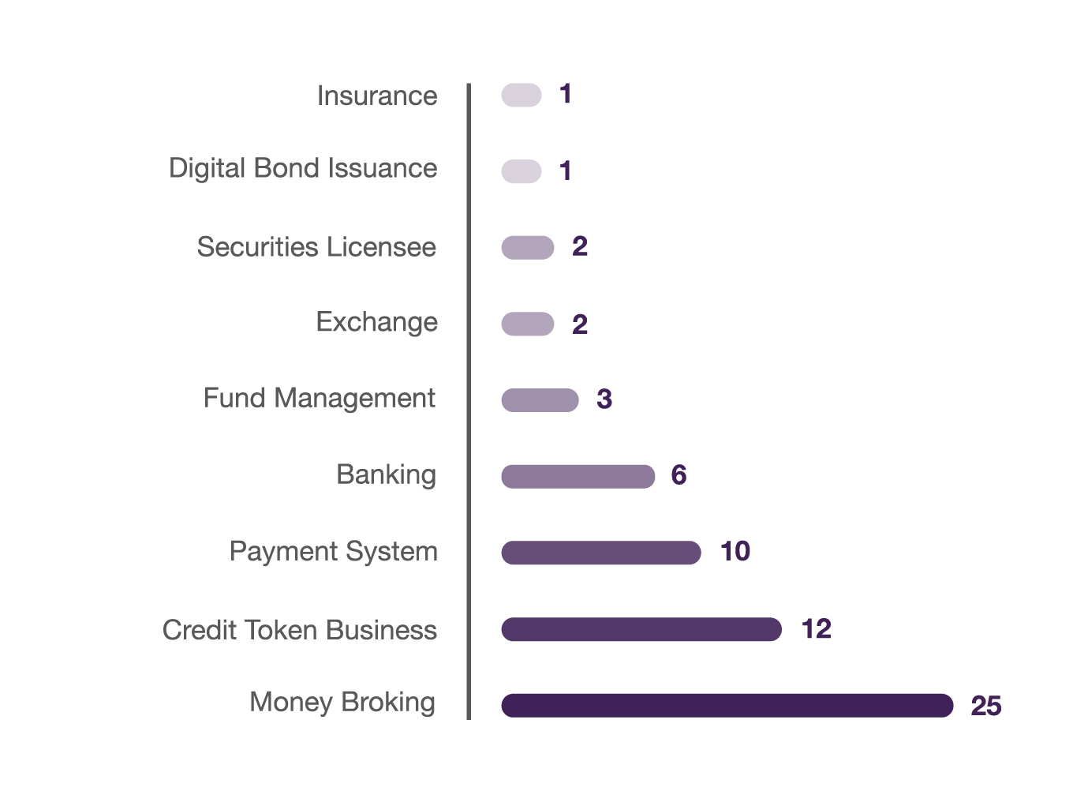
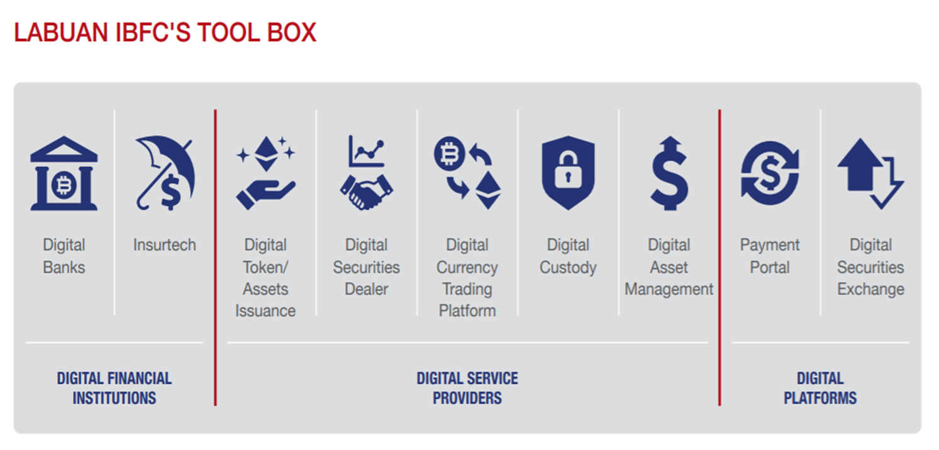
2020 Highlights
Digital Financial Services
Agility, Adaptability, Alignment
The ethos of Digital Labuan is that there are no ‘sandboxes’; Digital financial service providers are able to operate within framework of existing laws and regulations.
Labuan IBFC has a ready ‘tool box’ for blockchain, cryptocurrencies and fintech-related entities namely via money broking licence, credit token licence, securities dealer licence, payment portal approval etc. It is worth noting that licences may be combined to achieve the operational objectives of a potential digital licence holder.
Has in total 62 digital financial services providers.
30 licences were approved, predominantly token issuers, e-payment portal and digital assets trading platform providers.
4 new digital investment banks were approved. To date, Labuan IBFC is home to 6 digital banks.
Home to 3 digital exchanges, i.e. Labuan International Financial Exchange, Fusang Exchange and GSX Exchange.

Slide 11
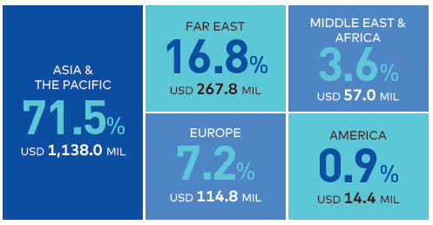
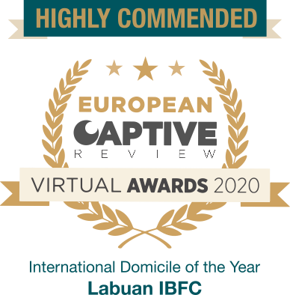
2020 Highlights
Insurance & Risk Management
Agility, Adaptability, Alignment
Insurance and risk management is the largest sector in Labuan with more than 220 license holders.
Labuan insurance industry comprises (re)insurers and captive insurers which underwrite either general or life business and other insurance related intermediaries. As with all our offerings, Labuan (re)insurance comprises both conventional insurance as well as shariah compliant, takaful business.
Labuan captives have grown to become a prominent business sector in the centre with 55 captives and is now licensing a quarter of all captives in the Asia-Pacific and Mena.
In fact, Labuan IBFC is the only Asian jurisdiction with a comprehensive legal framework to cater for PCC structure.
Total gross premiums grew 4.5% to USD1.6 billion, of which foreign business forms the larger share of 60.9%.
Gross premium distributions by region
Captive insurance attributes 31.2% of total gross premium underwritten in Labuan IBFC with 65.4% originated from international markets.
Labuan IBFC won the “Highly Commended” award at the European Captive Awards 2020 under the category “International Domicile of the Year”.

Slide 12
2020 Highlights
Islamic Finance
Agility, Adaptability, Alignment
Labuan IBFC has in place a complete suite of Islamic financial structures and solutions, effective regulatory standards, a facilitative business environment as well as a Shariah Supervisory Council for Islamic business.
The Centre has its world’s first omnibus legislation governing all Islamic businesses, which covers not only Islamic banks and financial service providers, but also (re)takaful businesses, Islamic wealth management (Waqf foundation, Islamic private foundation, Islamic trust), sukuk issuances, ijarah leasing and Islamic digital offerings
Labuan IBFC is home to the world's first USD denominated exchangeable sukuk.
Labuan together with onshore regulators committed to develop Malaysia as the Islamic finance leader under the MIFC initiative.
Islamic Banking
Total Islamic deposits at Labuan’s 20 Islamic banks (including the conventional banks with Islamic windows) increased by 8.5% to USD183.1 million
Takaful Business
The total gross contributions of general (re)takaful industry showed encouraging double digit business growth of 13.8% to USD114.5 million.
Islamic
listing and capitalisation
Labuan Financial Exchange has 9 sukuk listed at a combined value of US$ 5.5billion, representing 23.1% of total market capitalisation.

Slide 13
Strategic Direction
Enhancing the Sustainability and Relevancy of Labuan IBFC
Expand and Strengthen
Financial Ecosystem
Regulatory and
Supervisory Modernisation
Visibility Enhancement and
Branding Strategy
BUSINESS INTENSIFICATION
RESPONSIVE REGULATIONS AND SUPERVISION
PROFILING AND VISIBILITY OF LABUAN IBFC
To enhance business facilitation and invigorate identified key business sectors.
Review and align business regulations
Enhance digital conducive ecosystem
Tap into full potential of Labuan insurance market
Revitalize Labuan banking business
Attract targeted brands and facilitate intra-Labuan business
Strengthen and expand functions of key intermediaries
To modernise regulatory and supervisory approach with forward-looking requirements; and strengthen market monitoring and enforcement capability to ensure continued market stability.
Upscale proportionate regulations to suit new business developments
Refine supervisory approach to cater for emerging risks
Inculcate greater international regulatory and supervisory cooperation
To foster closer collaboration with key stakeholders to enhance prominence of Labuan IBFC.
Active participation and involvement in international bodies and forum
Reinforce strategic ties and create greater synergies with key stakeholders through MoUs
Strategic communication to enhance timely information exchanges and responses to public
Joint collaboration with the industry to provide cohesive support to the Labuan community
ENHACNING ORGANISATIONAL REPUTATION AND DELIVERY EFFICIENCIES
To continue to enhance organisational reputation, capabilities and to drive operational efficiencies
Improve key facilities via digital solutions to support organisational needs
Strengthen reliability of key digital service platforms
Prudent financial management of Labuan FSA
Continue upskilling of internal competencies and new skillsets in line with market development

Slide 14
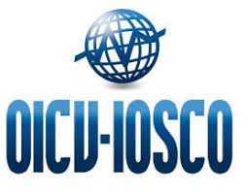
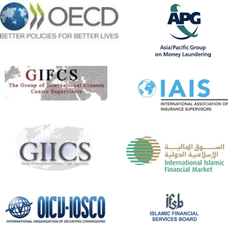





Why Labuan IBFC?
REGIONAL OPPORTUNITIES
EFFICIENT AND FLEXIBLE
TAX SYSTEM
Southeast Asia is estimated to be 4th largest economy by 2050, investors and businesses can gain access to a larger marketplace into the region via Labuan IBFC.
Simple and straightforward tax system to carry out a Labuan business activity as defined by the Labuan Business Activity Tax Act 1990.
SUBSTANCE CREATION
AND TRANSPARENCY
WELL – REGULATED JURISDICTION
EASE OF DOING
BUSINESS
Complying with the latest global regulatory standards including requirements for transparency and substance creation.
A robust regulatory framework to ensure entities remain in compliance with international best standards.
Ease of doing business with cost – effective solutions and structures.
WIDE ARRAY OF SOLUTIONS AND STRUCTURES INCLUDINGS SHARIAH – COMPLIANT OPTIONS
Banking | Risk Management | Leasing | Wealth Management | Commodity Trading | Protected Cell Companies | International Business Companies
GLOBALLY RECOGNISED INDUSTRY MEMBERSHIPS AND RECOGNITIONS

Slide 15
Disclaimer
This presentation should not be regarded as offering a complete explanation of the matters referred to and is subject to changes in law. It is not intended to be a substitute for detailed research or the exercise of professional judgment. Labuan IBFC cannot accept any responsibility for loss occasional to any person acting or refraining from action as a result of any material in this presentation. The republication, reproduction or commercial use of any part of this presentation in any manner whatsoever, including electronically, without the prior written permission from Labuan IBFC Inc. is strictly prohibited.

