Slide 1
LABUAN IBFC:
ASIA’S WHOLESALE INTERMEDIATION CENTRE

Slide 2
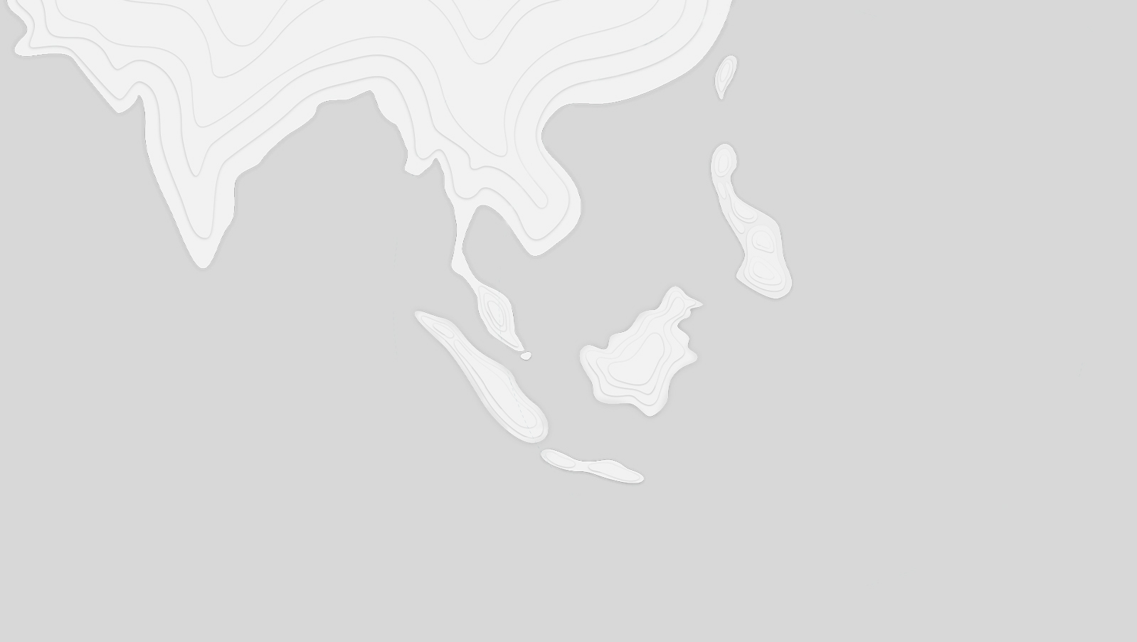


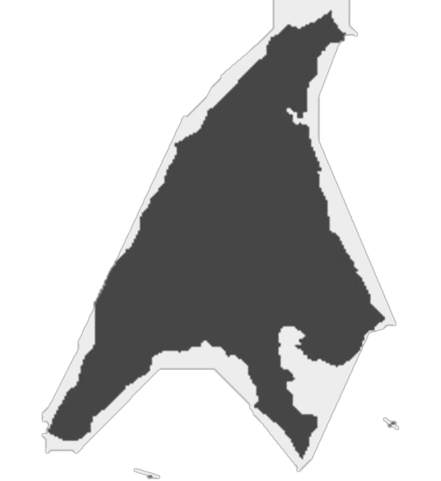

Where is Labuan?
OUR ECONOMIC DRIVERS
International Business & Financial Centre
Logistics
Kuala Lumpur
LABUAN
Tourism
Labuan is part of Malaysia, a Federal Territory under the Federal Government.
Located off the coast of Sabah, East Malaysia, in the center of Asia. Labuan derived its name from the word “labuhan” or a port - has naturally deep, well-sheltered harbour.
Easy access from Kuala Lumpur and Kota Kinabalu. Has a total population of about 100,000 people.
Oil & Gas
Retail Trading

Slide 3


Labuan IBFC – Gateway to Asia Pacific
More than 30 Years of Intermediating Asia
An international business and financial centre set up by Malaysia in 1990 to intermediate trade, finance, risk and wealth.
A tax-efficient substance enabling MIDSHORE jurisdiction to facilitate businesses, trading, investments through financial services and a wide array of legal structures.
Well-balanced legal and regulatory framework, proportionality in regulatory stance.
Robust governing legislations passed by the Malaysian Parliament, administered by Labuan Financial Services Authority, a statutory body under the Ministry of Finance, Malaysia.
Adheres to Malaysia’s AMLCFT requirements and international standards and best practices set by multilateral global institutions.

Slide 4
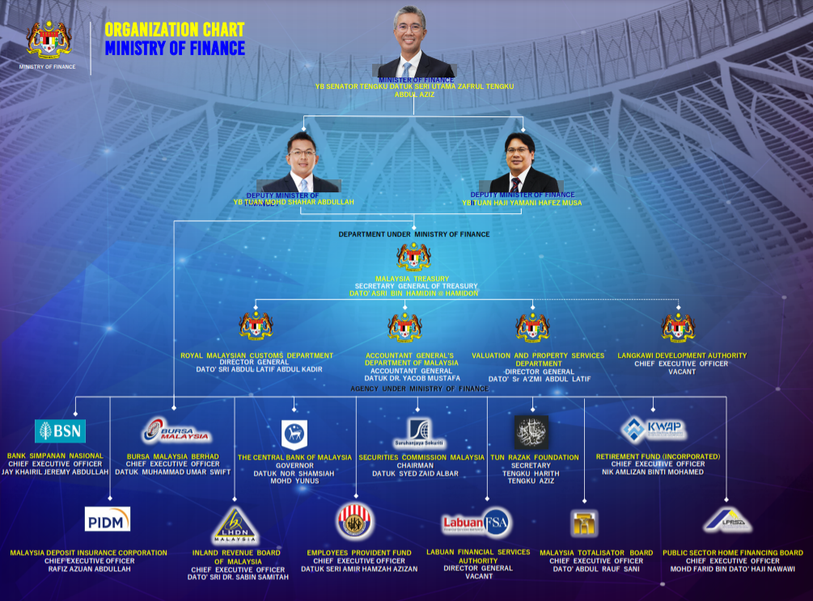
THE
REGULATOR
Labuan Financial Services Authority
Labuan Financial Services Authority a statutory body under Ministry of Finance, Malaysia1
NIK MOHAMED DIN NIK MUSA

Slide 5


Why the Mid-shore Balance?
Labuan is part of Malaysia, one of Asia’s fastest growing nations. Labuan IBFC is thus part of all the protocols the country adheres to, such as anti-money laundering and anti-terrorism financing regulatory requirements.
Conformity to international standards and regulatory requirements by international standards setting bodies such as OECD, APG, FATF, have always been key to Labuan IBFC.
Labuan IBFC has put in place relevant legislation to allow the exchange of information with the tax authorities of Malaysia’s double tax treaty partners as well as the tax information exchange agreements signed by Malaysia.
The range of unique and bespoke structures are cost-efficient, tax and currency neutral.

Slide 6

A Comprehensive Suite of Legislation
Adherence to International Standards and Best Practices
1
3
Labuan FSA
2
Labuan Financial Services Authority Act 1996
Labuan Companies Act 1990
Labuan Financial Services and Securities Act 2010
Labuan Islamic Financial Services and Securities Act 2010
Labuan Trusts Act 1996
Labuan Limited Partnerships & Limited Act 2010
Acts of General Applications include
Anti-Money Laundering and Anti Terrorism Financing and Proceeds of Unlawful Activities Act 2001
Mutual Assistance in Criminal Matters Act 2002
Malaysia Anti – Corruption Commission Act 2009
National Anti- Financial Crime Centre Act 2019
BNM’s Foreign Exchange Notices
Inland Revenue Board
Labuan Business Activity Tax Act 1990 (LBATA)
Income Tax Act 1967 – including relevant gazette orders
Stamp Act 1949

Slide 7
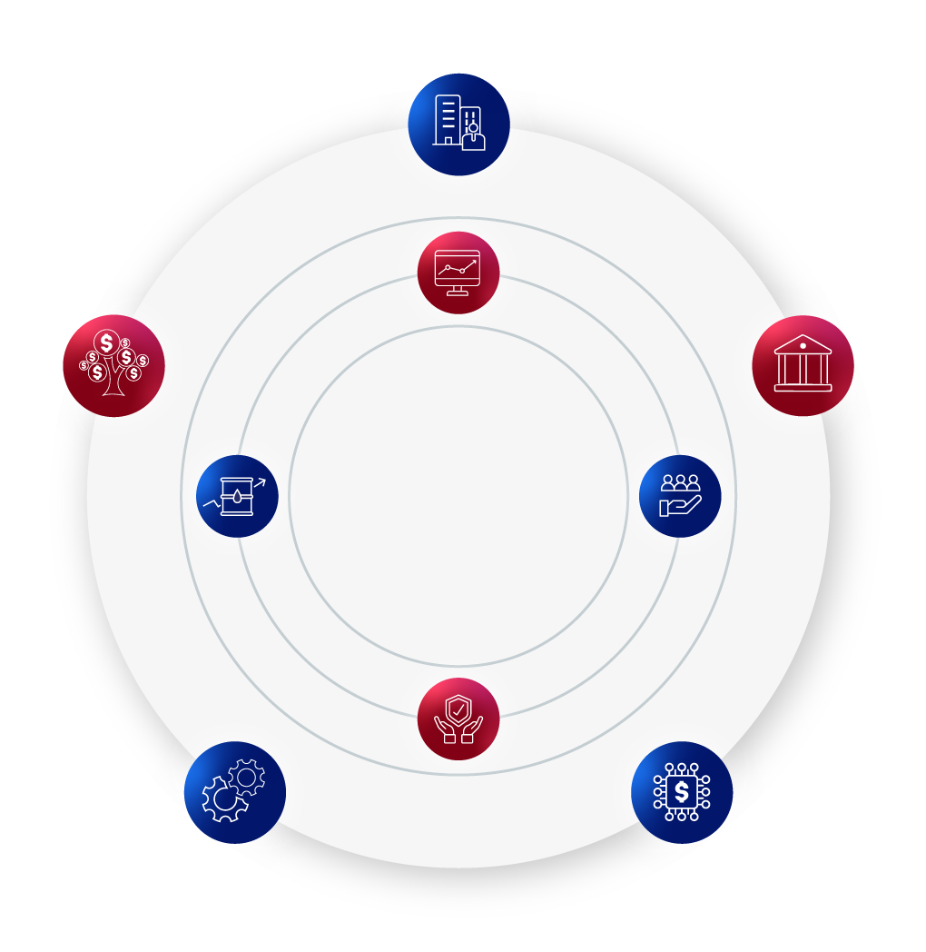
Creating A Complete Ecosystem of Solutions
Companies
Available in conventional, digital and Shariah-compliant forms
Wealth Management
Capital
Market
Banking
Commodity Trading
Trust Companies
Leasing
Insurance
Digital Market

Slide 8
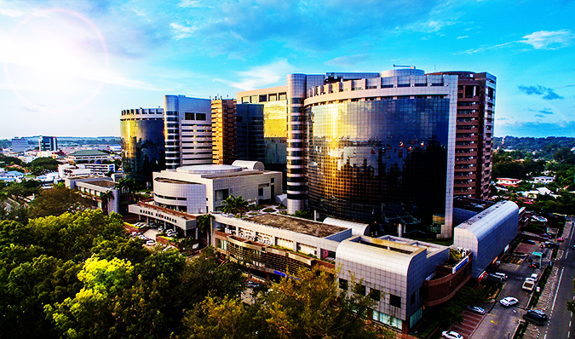
Fiscal Structure and Corporate Entity Benefits
Tax Structure
Business and Investment Activities
  Income from Labuan trading activities (as defined) taxed at 3% of net audited profits
  Non-trading income (e.g. from investment holding activities) attracts no tax
  Clear and prescribed Substance Requirements based on business activities via a Gazette issued by Parliament of Malaysia
  Fiscal Regime is perpetual not time bound
Other Benefits
  Exemption from withholding tax on dividends, interest, royalties, service fees and lease payments to non-residents
  Exemption from stamp duty
  Access to most of Malaysia’s 70+ double taxation agreements*
  100% foreign ownership
  Access to live in Malaysia
  * Labuan entities enjoy the benefits of most of Malaysia’s tax treaties, but certain treaties have specifically excluded Labuan entities from treaty benefits

Slide 9








































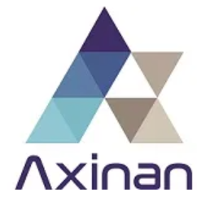












Home to International Brands
Banks
Insurance & Captives
Trust Companies
Leasing
Labuan International
Trading Companies
(LITCs)
Digital Financial
Services

Slide 10






Why Labuan IBFC?
REGIONAL OPPORTUNITIES
EASE OF DOING
BUSINESS
Southeast Asia is estimated to be 4th largest economy by 2050, investors and businesses can gain access to a larger marketplace into the region via Labuan IBFC.
Ease of doing business with cost – effective solutions and structures.
SUBSTANCE CREATION
AND TRANSPARENCY
WELL – REGULATED JURISDICTION
Complying with the latest global regulatory standards including requirements for transparency and substance creation.
A robust regulatory framework to ensure entities remain in compliance with international best standards.
EFFICIENT AND FLEXIBLE TAX SYSTEM
Simple and straightforward tax system to carry out a Labuan business activity as defined by the Labuan Business Activity Tax Act 1990.

Slide 11
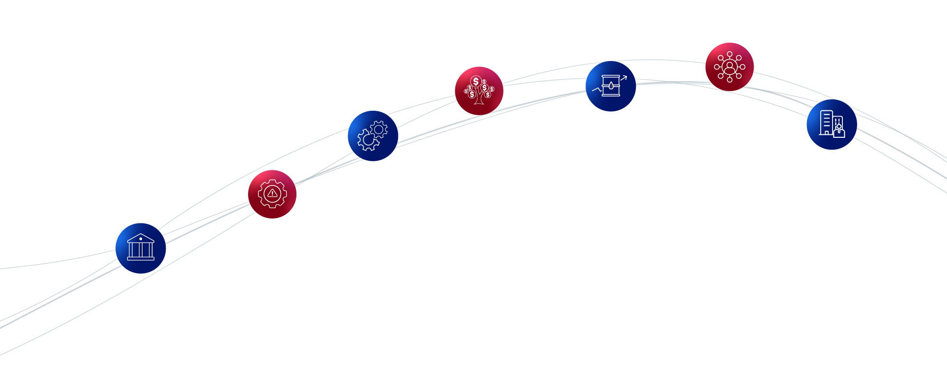
Wide Array of Solutions and Structures Including Shariah – Compliant Options
Protected Cell Companies
Wealth Management
Leasing
Commodity Trading
International Business Companies
Banking
Risk Management

Slide 12

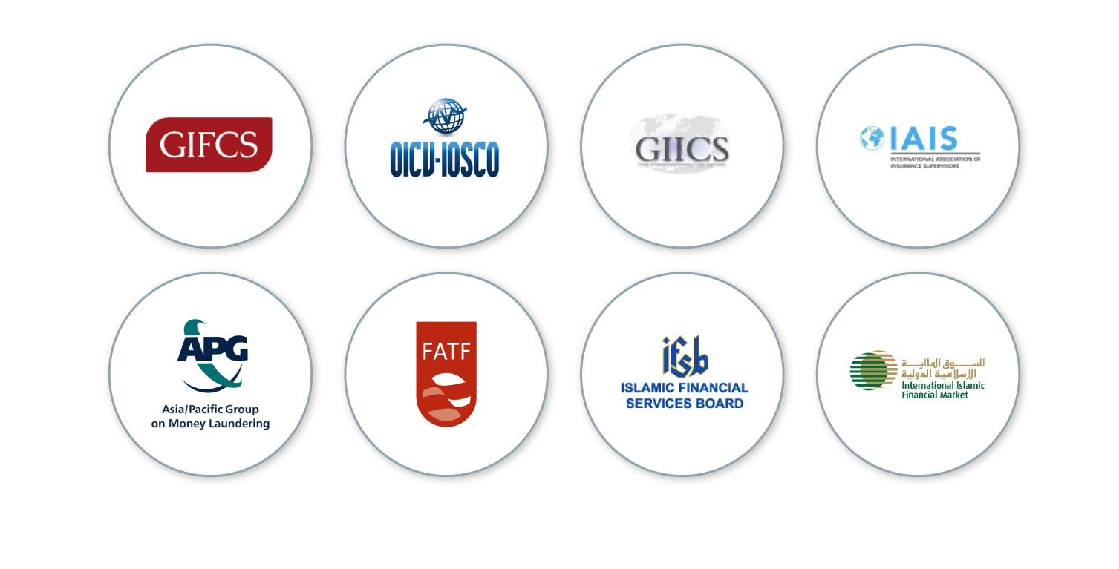
Globally Recognised Industry Memberships and Recognitions

Slide 13
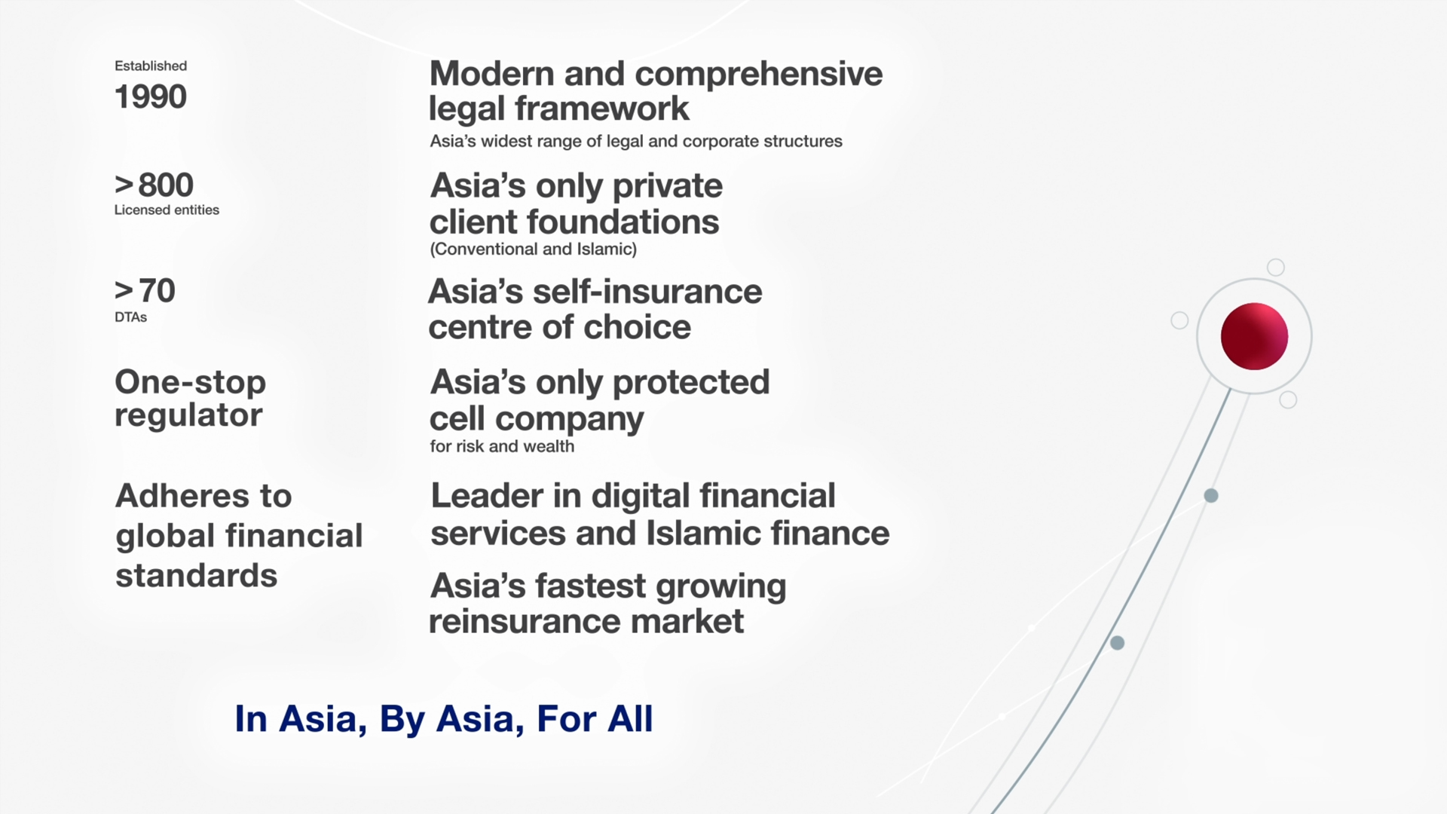
Other Benefits

Slide 15
Disclaimer
This presentation should not be regarded as offering a complete explanation of the matters referred to and is subject to changes in law. It is not intended to be a substitute for detailed research or the exercise of professional judgment. Labuan IBFC cannot accept any responsibility for loss occasional to any person acting or refraining from action as a result of any material in this presentation. The republication, reproduction or commercial use of any part of this presentation in any manner whatsoever, including electronically, without the prior written permission from Labuan IBFC Inc. is strictly prohibited.

